Slide 1
Guaranteed Availability Network Function Virtualization with Network Protection and VNF Replication
Jian Kong , Inwoong Kim , Xi Wang , Qiong Zhang, Hakki C. Cankaya, Weisheng Xie, Tadashi Ikeuchi, and Jason P. Jue
Presenter: Congzhou Li

Slide 2
Contents
Introduction
Problem Statement
Heuristic Algorithm
Simulation Results
Conclusion

Slide 3
Introduction
we propose a coordinated protection mechanism that adopts both backup path protection in the network and VNF replicas at nodes to guarantee a SFC’s availability.
The proposed mechanism determines the number of replicas required for each VNF in the SFC, and allocates the replicas to physical nodes on the working and backup paths while maintaining ordered dependency among VNFs.
Simulation results show that the proposed algorithms contribute to reducing the SFC blocking and the cost of computing resources

Slide 4
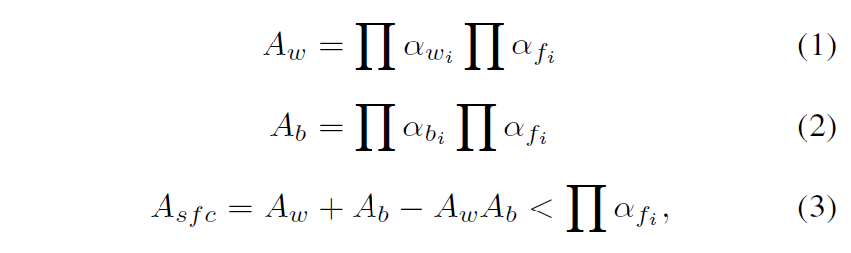
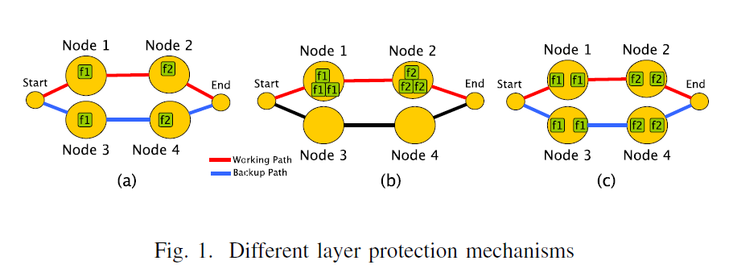
Problem Statement
A. Availability of the SFC mapping:
1) network-layer protection

Slide 5

Problem Statement
A. Availability of the SFC mapping:
2) application-layer protection

Slide 6
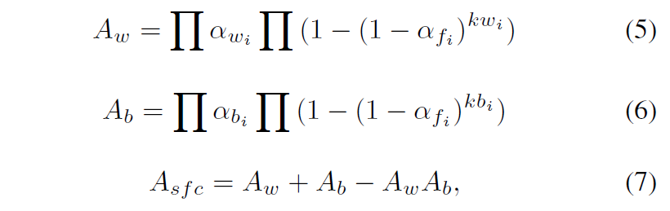
Problem Statement
A. Availability of the SFC mapping:
3) coordinated protection

Slide 7
Problem Statement
B. Problem definition:
Input:
a physical inter-datacenter network 𝐺(𝑉𝑝,𝐸𝑝). The availability and cost of links.
The SFC request 𝑆(𝐹𝑠,𝐵, 𝑆𝐴),.
Output:
the working path and backup path (if needed) for the SFC
the number of replicas for each VNF
the placement of replicas along the working and backup path

Slide 8
Problem Statement
B. Problem definition:
Objective:
minimize SFC blocking and to minimize the use of computing resources while guaranteeing the SFC’s availability requirement.
Assumptions:
For one specific VNF, its replicas have the same availability and consume the same amount of computing
resources.

Slide 9

Heuristic Algorithm
Is there a need to provide physical layer protection?
Link-cost-based path algorithm:
Check the availability of path found with at most L replicas
2) Availability-based path algorithm:
Constructing an auxiliary graph $G_{a}$
Find the minimum-weight path in $G_{a}$

Slide 10

Heuristic Algorithm
B. How to distribute the replicas between the working and backup paths?
Vulnerable-vnf-first replicas algorithm:
Idea: provide replicas for the VNFs that have the lowest
availability.

Slide 11
Heuristic Algorithm
B. How to distribute the replicas between the working and backup paths?
2) path-balance replicas algorithm:
lemma1:
Given:
the availability 𝛼𝑓 of VNF 𝑓1
the availability 𝛼1 of the working path
the availability 𝛼2 of the backup path.
𝐾 (𝐾 >1) replicas for 𝑓1

Slide 12

Heuristic Algorithm
B. How to distribute the replicas between the working and backup paths?
2) path-balance replicas algorithm:
lemma1:
Given:
the availability ${\text{α}}_{\text{f}}$of VNF ${\text{f}}_{1}$
the availability ${\text{α}}_{1}$ of the working path
the availability ${\text{α}}_{\text{2}}$ of the backup path.
𝐾 (𝐾 >1) replicas for ${\text{f}}_{1}$

Slide 13
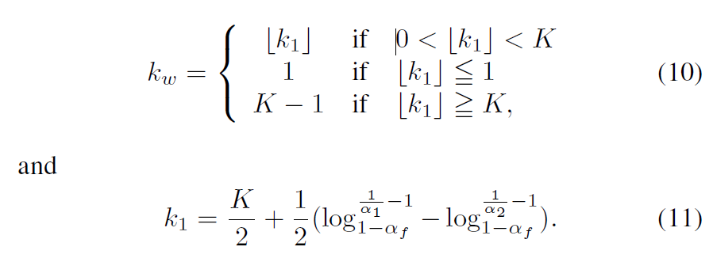
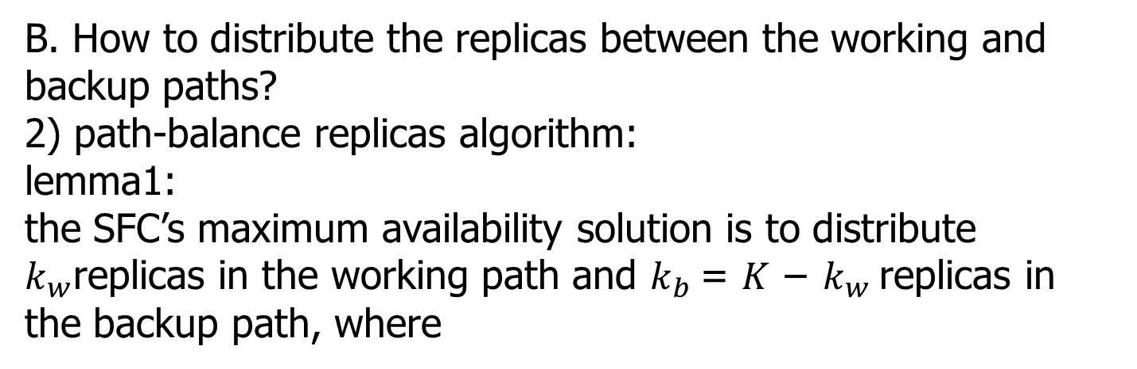
Heuristic Algorithm
B. How to distribute the replicas between the working and backup paths?
2) path-balance replicas algorithm:
lemma1:
the SFC’s maximum availability solution is to distribute
$k_{w}$replicas in the working path and $k_{b}$= 𝐾 − $k_{w}$replicas in
the backup path, where

Slide 14

Heuristic Algorithm
B. How to distribute the replicas between the working and backup paths?
2) path-balance replicas algorithm:
lemma2:
Assume that there are at least two replicas
($k_{w}$> 1 and $k_{b}$> 1)
for one VNF ${\text{f}}_{1}$ on the working path and at least two replicas
on the backup path. If we can reduce two replicas of the VNF
${\text{f}}_{1}$ the SFC’s maximum availability solution is to remove one
replica from both the working path and the backup path

Slide 15

Heuristic Algorithm
B. How to distribute the replicas between the working and backup paths?
3) Vulnerable-vnf-path-balance replicas algorithm:
Initially, each VNF has one replica on the working path and one on the backup path.
We determine the VNF ${\text{f}}_{i}$with the lowest availability based on Eq.(9).

Slide 16

Heuristic Algorithm
B. How to distribute the replicas between the working and backup paths?
3) Vulnerable-vnf-path-balance replicas algorithm:
We increase the number of replicas of ${\text{f}}_{i}$, distribute these replicas among the working path and the backup path based on Lemma 1,
repeat to find the replicas for all VNFs until the SFC’s availability can meet its requirement.

Slide 17
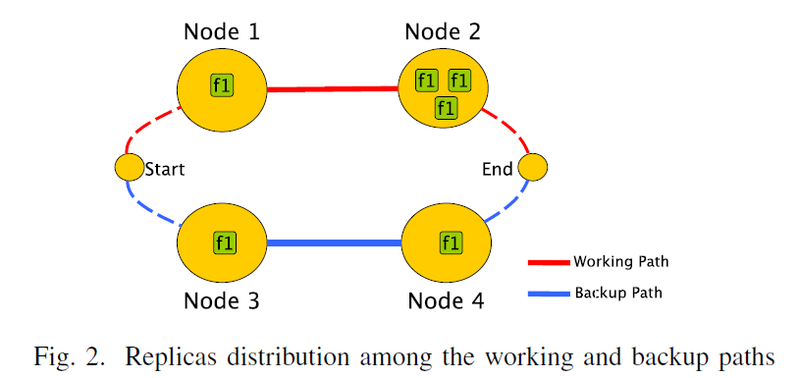

Heuristic Algorithm
C. Replicas balance deployment algorithm
lemma3:
For VNF $f_{i}$, The availability of the SFC will not be affected by how the $n_{w_{i}}$replicas are deployed along the physical nodes on the working chain or how the $n_{b_{i}}$ replicas are deployed along the physical nodes of the backup chain

Slide 18
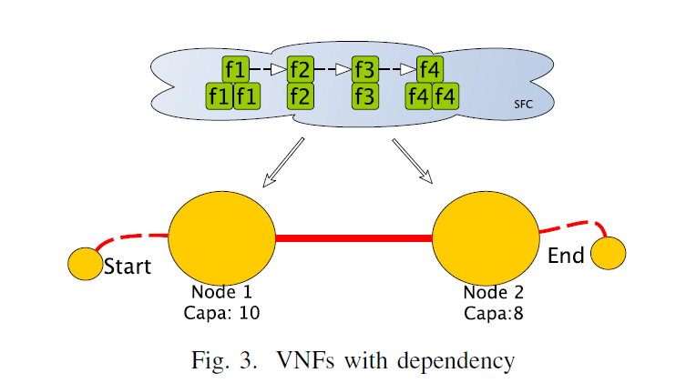
Heuristic Algorithm
C. Replicas balance deployment algorithm
VNF with dependency:

Slide 19
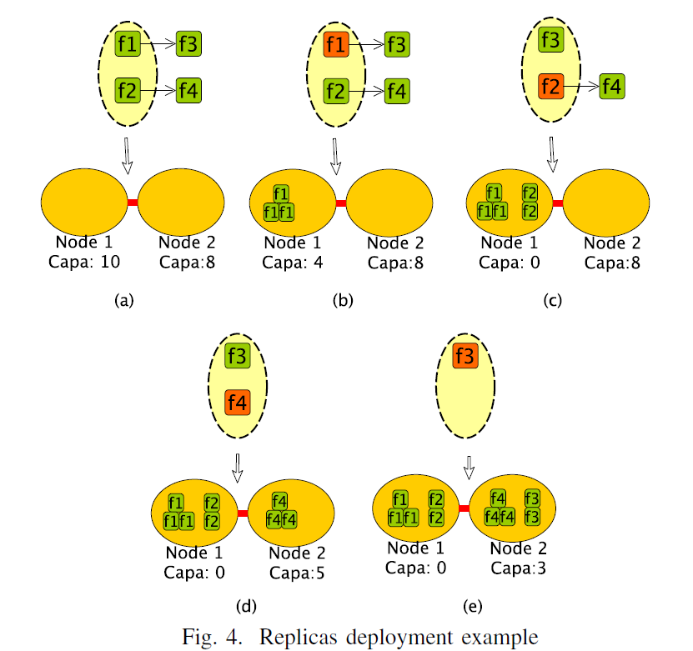
Heuristic Algorithm
C. Replicas balance deployment algorithm
VNF with dependency:

Slide 20
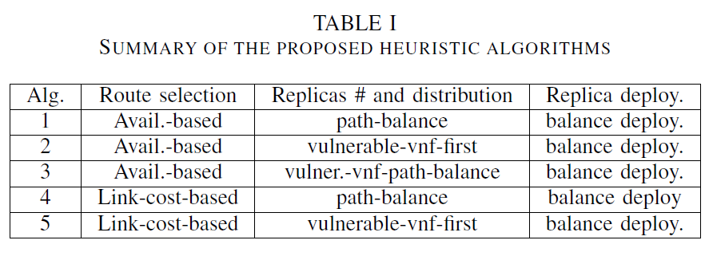
Heuristic Algorithm
D. SFC mapping heuristic algorithms

Slide 21
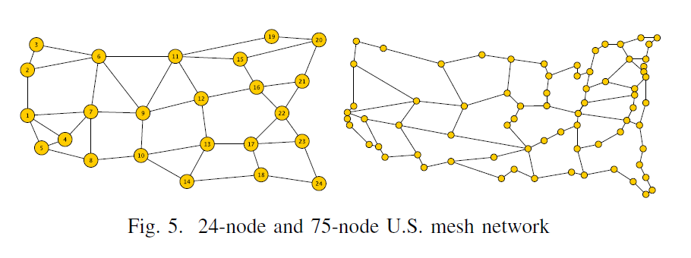
Results and Discussion
Test topology

Slide 22
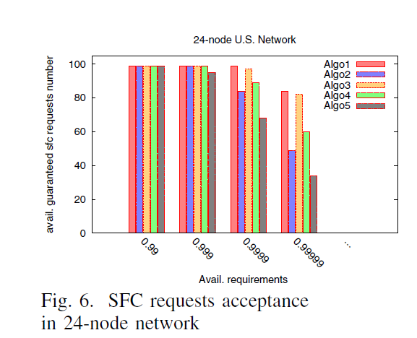
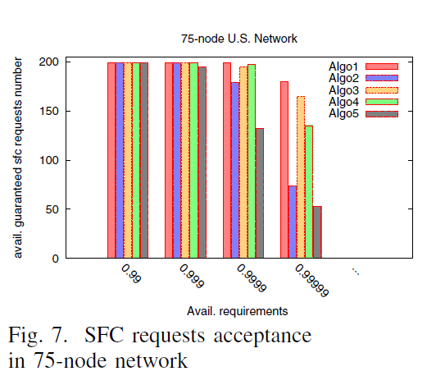
Results and Discussion
The performance of the algorithms in terms
of the SFC request acceptance

Slide 23
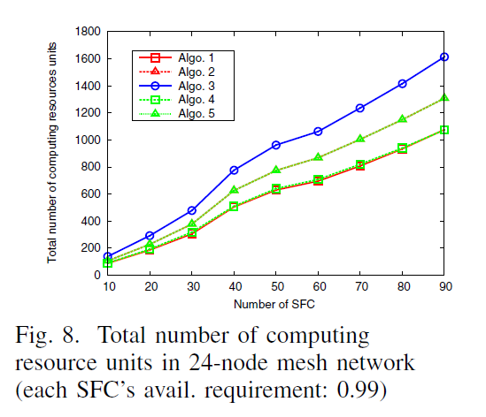
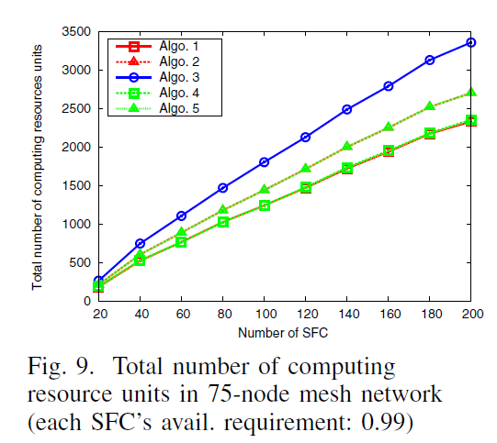
Results and Discussion
the total cost of computing resources and the total link cost

Slide 24
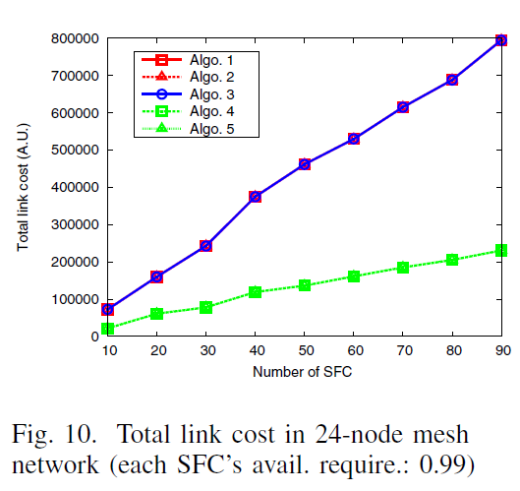
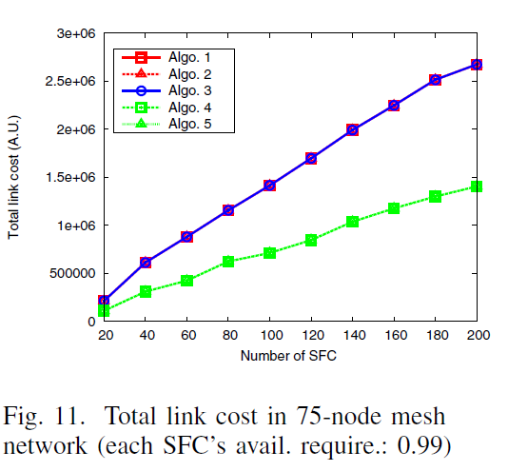
Results and Discussion
the total cost of computing resources and the total link cost

Slide 25
Conclusion
we propose efficient heuristic algorithms to determine the number of the replicas for each VNF of the SFC, and then allocate the replicas to the physical node by considering the dependencies among different VNFs
Numerical results show that the algorithms based on the 𝑝𝑎𝑡ℎ-𝑏𝑎𝑙𝑎𝑛𝑐𝑒 𝑟𝑒𝑝𝑙𝑖𝑐𝑎 𝑎𝑙𝑔𝑜𝑟𝑖𝑡ℎ𝑚 perform better in terms of reducing the total computing resources as well as reducing the SFC blocking.

